Slide 1

It is not the earthquake mate
– it is the buildings!
Ole Nielsen
Notes:
1

Slide 2
Australia-Indonesia Facility for Disaster Reduction
Australian Government AID Program
Supporting Indonesia’s capacity to manage consequences of natural disasters
Embedded in Indonesian Government
Partnerships with science agencies
Committed to Free and Open Source (sustainability, accessibility, reproducibility)

Slide 3

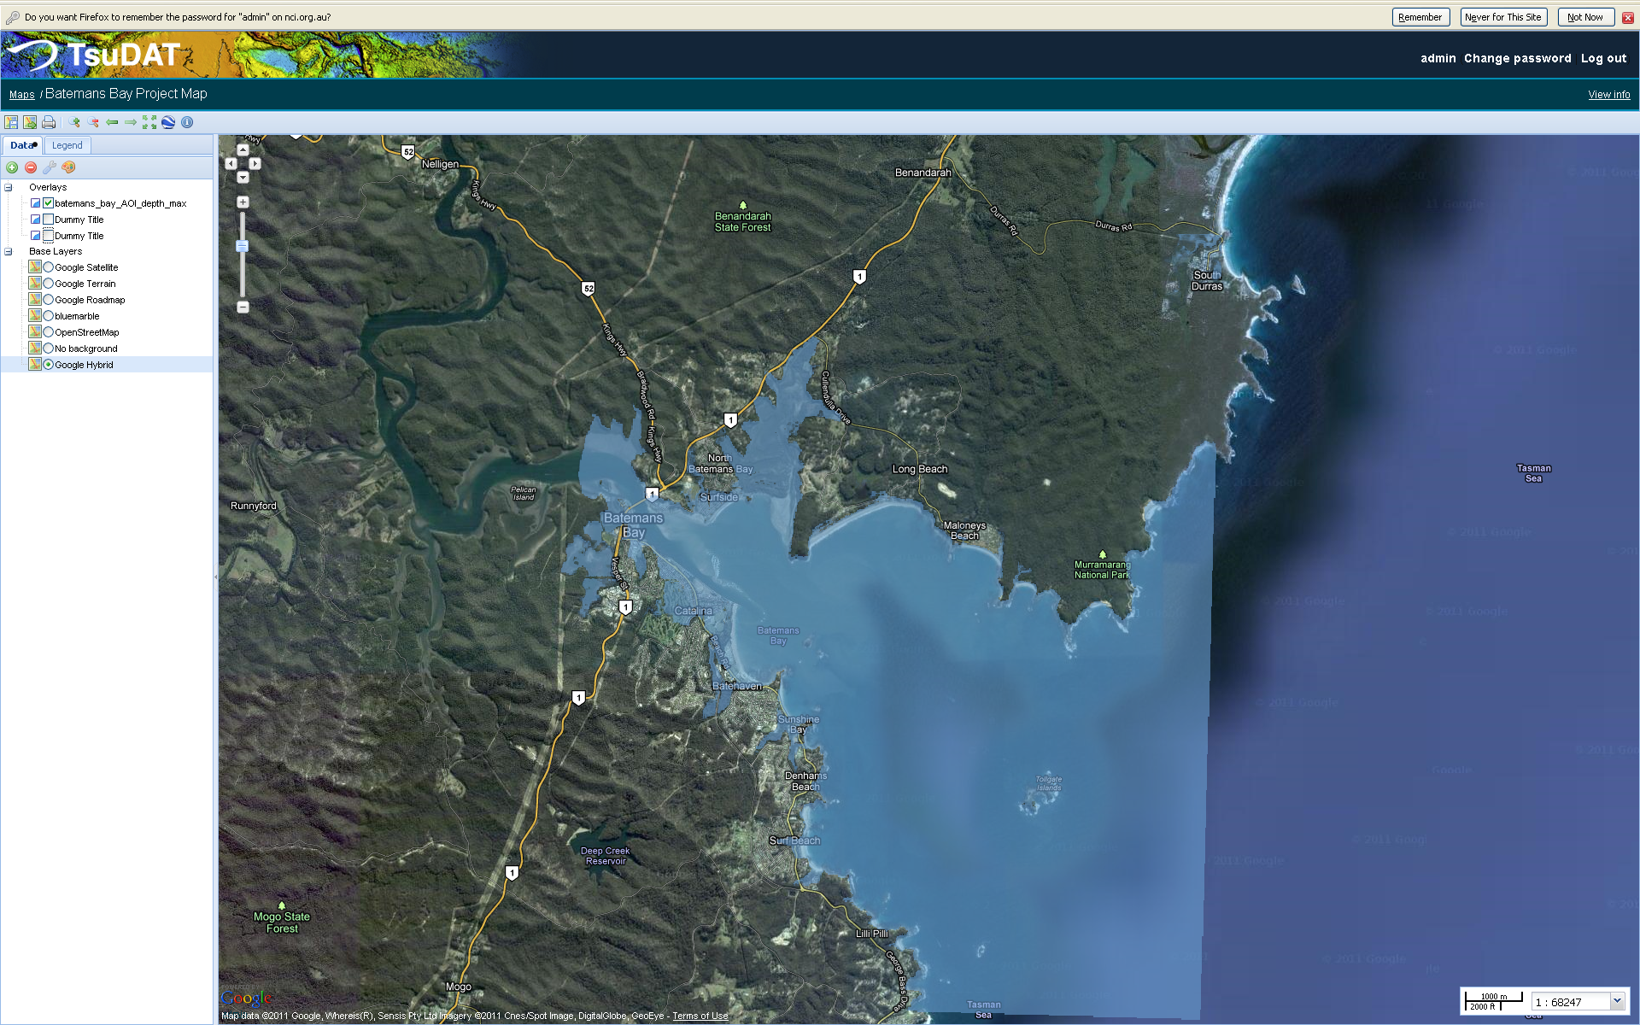
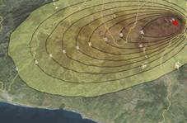


Open Source Python Modelling Tools
ANUGA: Hydrodynamic Hazards
EQRM: Probabilistic Earthquake Risk
TsuDAT: Tsunami Hazard
Python-FALL3D: Volcanic Ash
Risiko: Risk Mapping
Pypar: parallel computing

Slide 4
Four recent big earthquakes
Magnitude | Fatalities | $ Losses
7.0 | ? | ?
7.6 | ? | ?
8.8 | ? | ?
9.0 | ? | ?
Which one was the worst?

Slide 5

Earthquake | Magnitude | Fatalities | Losses (billion USD)
Haiti 2010 | 7.0 | ~200000 | ~8
Padang 2009 | 7.6 | ~1000 | ~2
Chile 2010 | 8.8 | ~500 | ~30
Hongshu 2011 | 9.0 | ~10000 (many from tsunami) | ~35
Sources: Wikipedia, Bappenas, USGS, NOAA
Notes:
It’s not just magnitude
Sources
http://www.scribd.com/doc/38038354/National-Policy-for-Recovery-Framework-Post-Earthquake-in-West-Sumatera-Province
http://en.wikipedia.org/wiki/2010_Haiti_earthquake
http://en.wikipedia.org/wiki/2010_Chile_earthquake
http://www.ngdc.noaa.gov/nndc/struts/form?t=101650&s=1&d=1
http://www.theaustralian.com.au/business/news/japans-earthquake-insured-losses-may-reach-35bn-says-disaster-modelling-company/story-e6frg90o-1226020875229

Slide 6
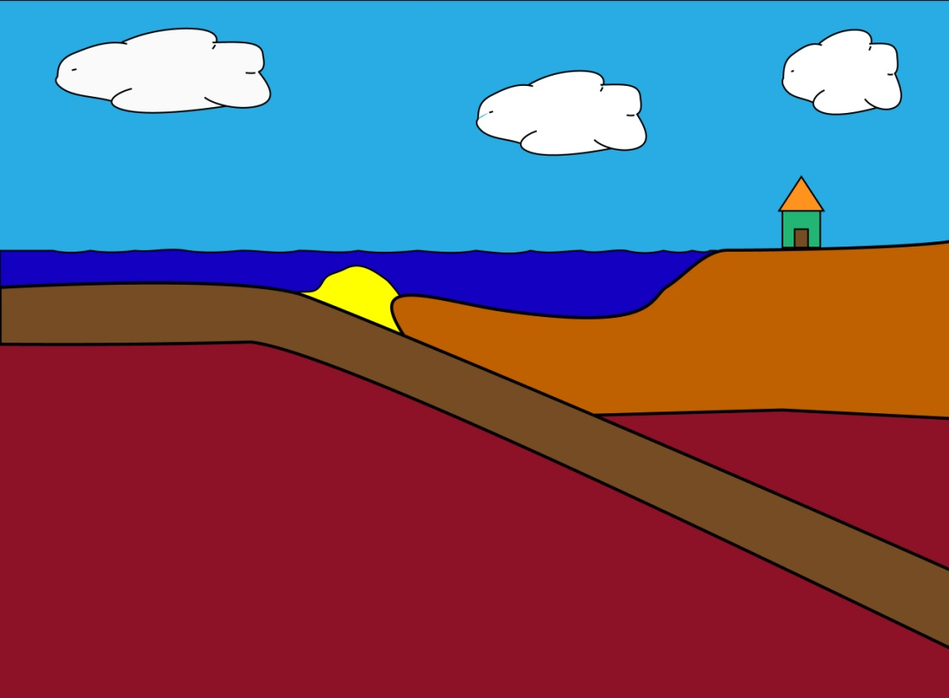
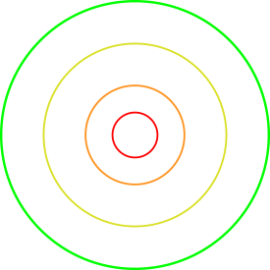

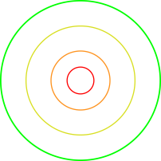
What determines the Impact of an Earthquake?
Ground Shaking
Magnitude
Depth
Distance (attenuation)
Soil type (site response)
Impact
Building Quality
Population
Value

Slide 7
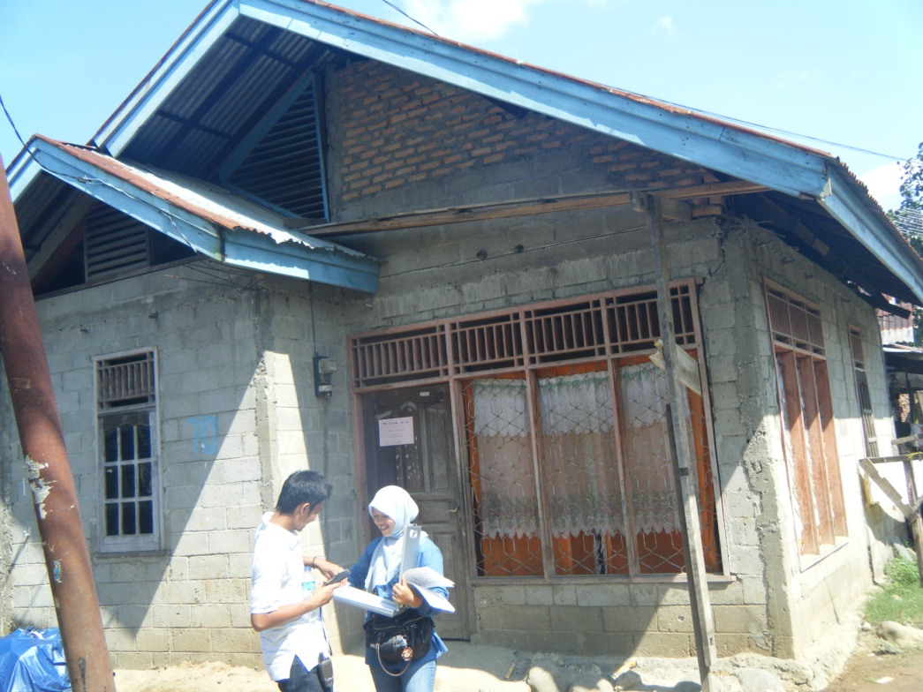
What makes an earthquake deadly? Lessons from Padang
Unreinforced
Confined
Notes:
Buildings, time of day, location

Slide 8
Survey Results

Slide 9


Slide 10
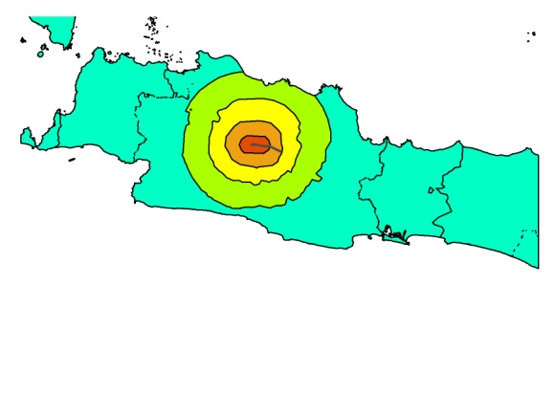
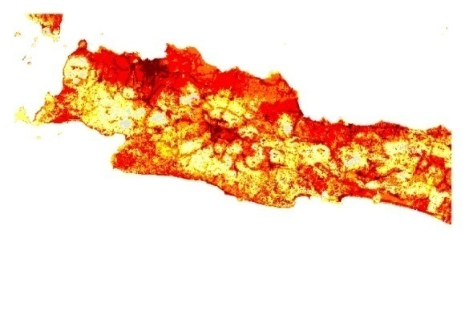
Generic Impact Mapping
Hazard Footprint
Exposure
Impact Function
100%
Fatalities
0%
MMI

Slide 11
Risiko
Framework for calculating spatial impact
Aims at underpinning risk assessment requirements where needed
Partnership with World Bank (Global Facility for Disaster Reduction and Recovery)

Slide 12
Risiko
Spatial data distributed using GeoServer
Input
Hazard map (earthquake ground shaking, tsunami inundation depth, volcanic ash load)
Exposure map (population density, buildings)
Plugin for calculating impact (vulnerability curves)
Output
Map of calculated impact at exposure locations
Specific statistics

Slide 13
Risiko components
Server Side
Django
Python (scipy, numpy, gdal, )
GeoServer
Client Side
Javascript (OpenLayers, GeoExt, )

Slide 14
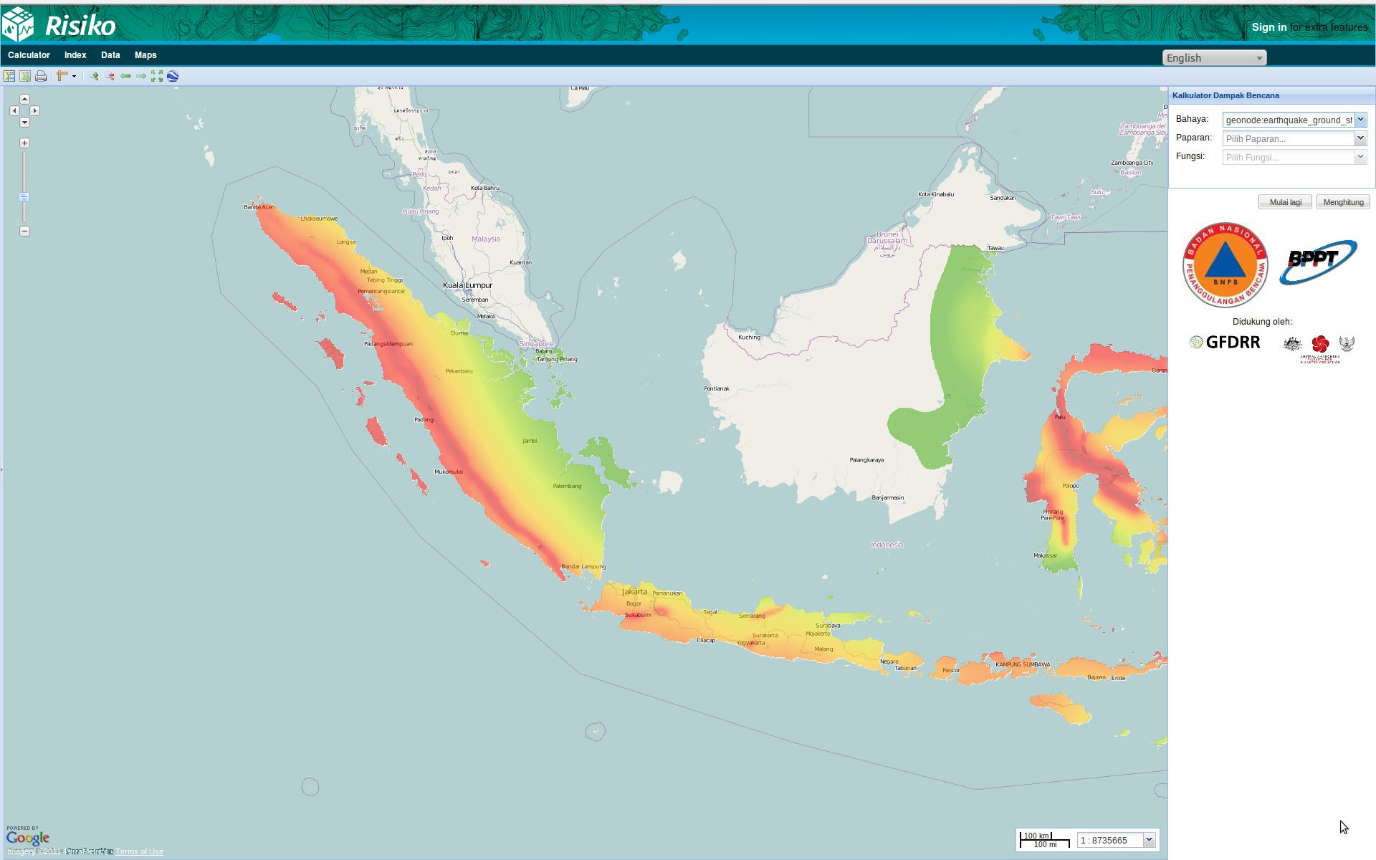

Slide 15
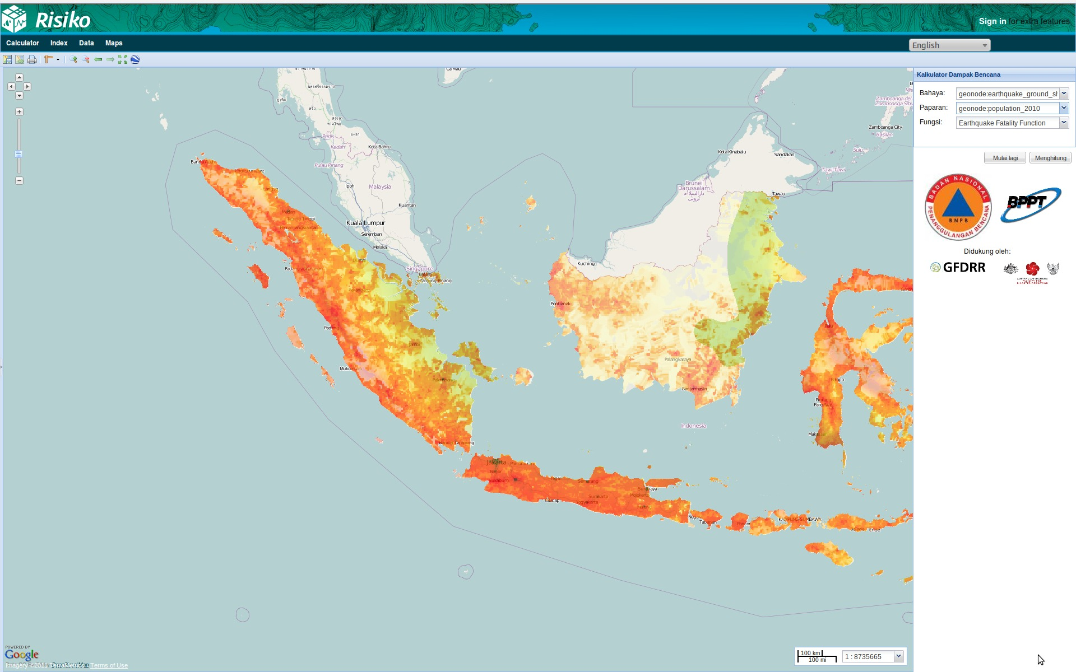

Slide 16
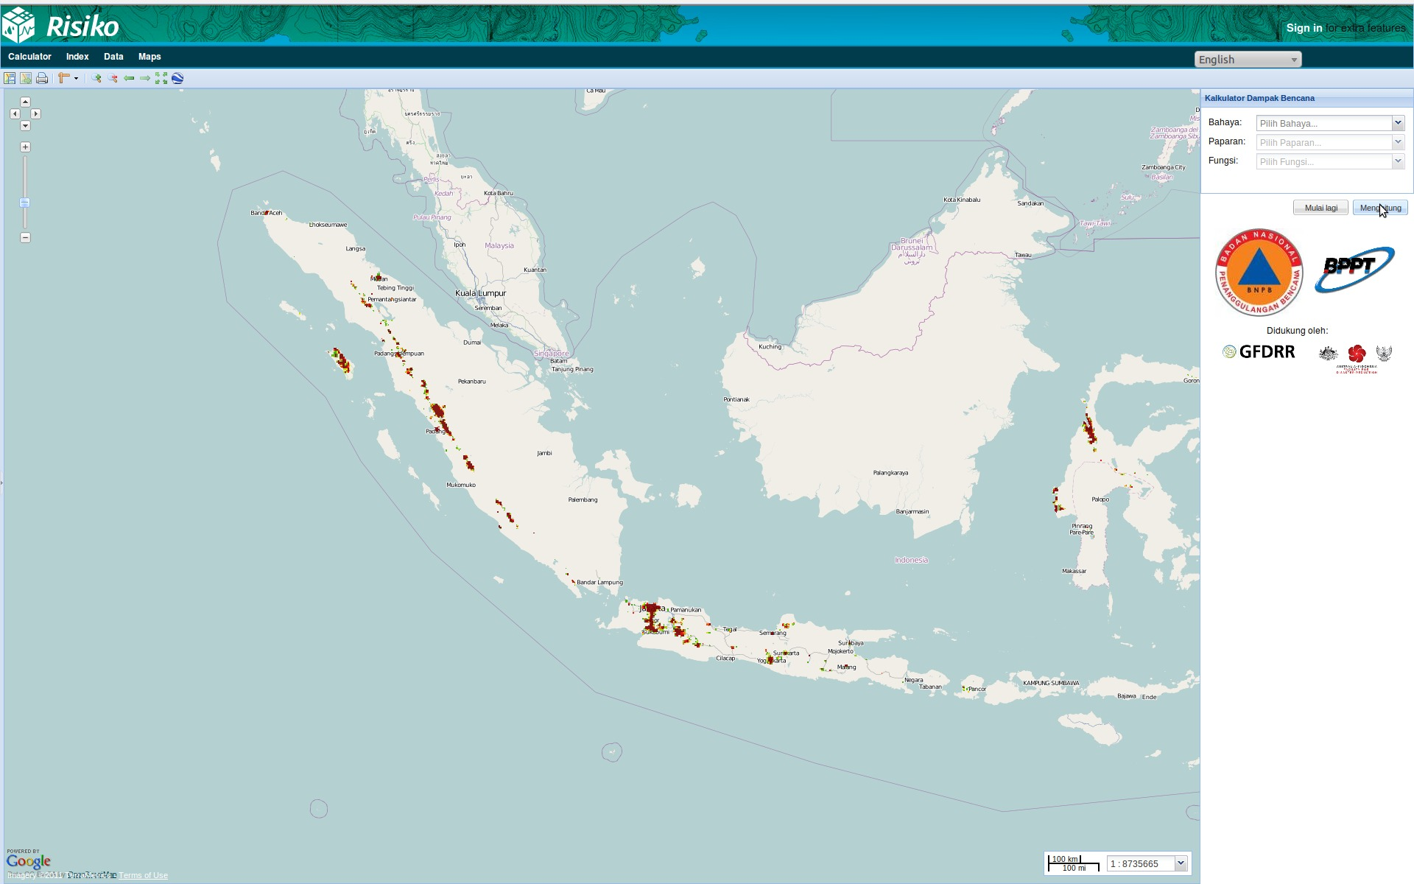

Slide 17
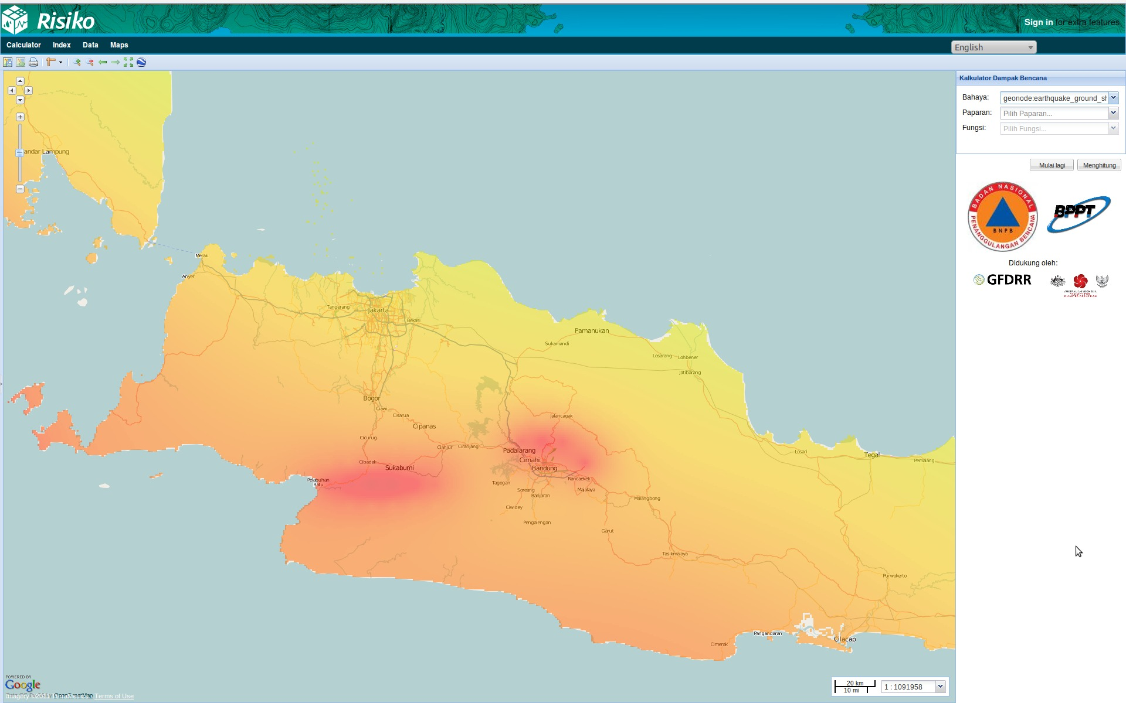

Slide 18
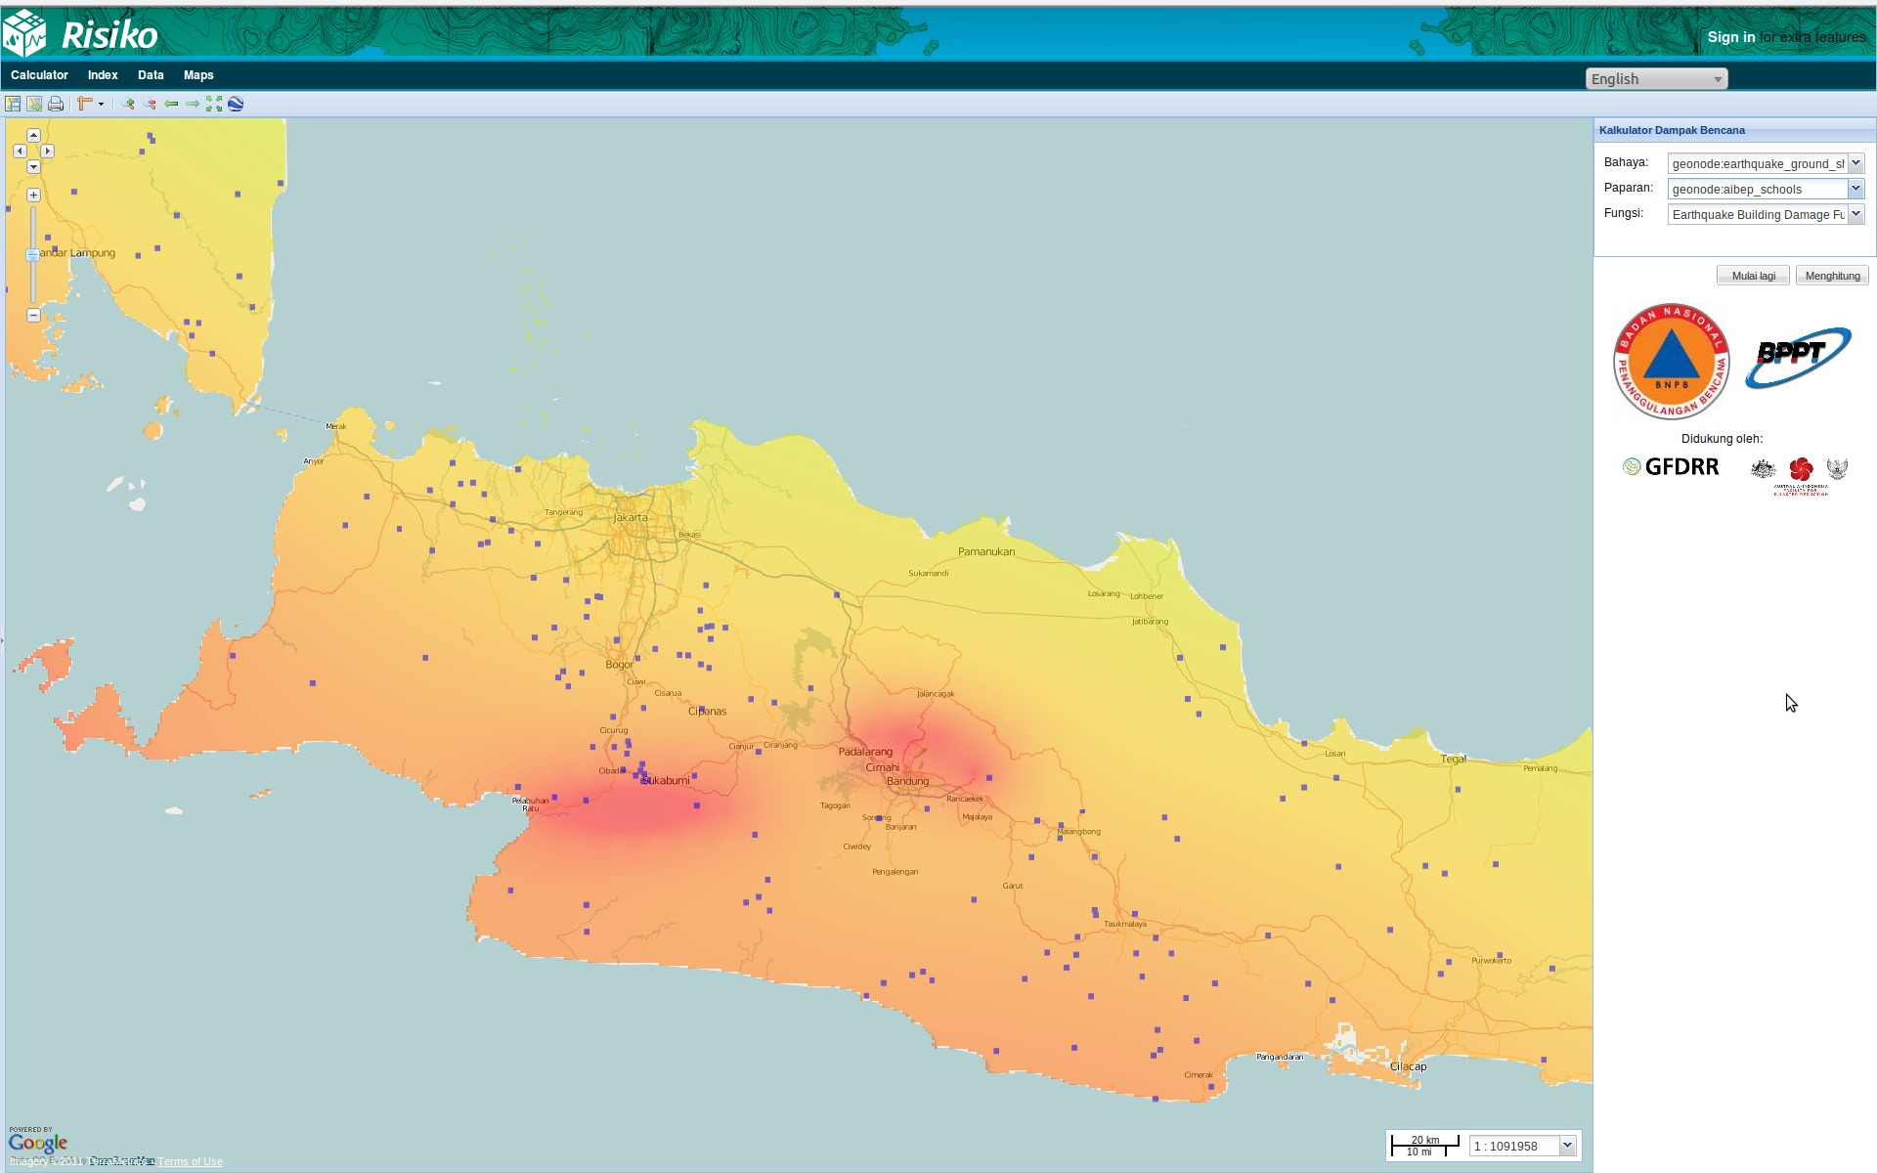

Slide 19
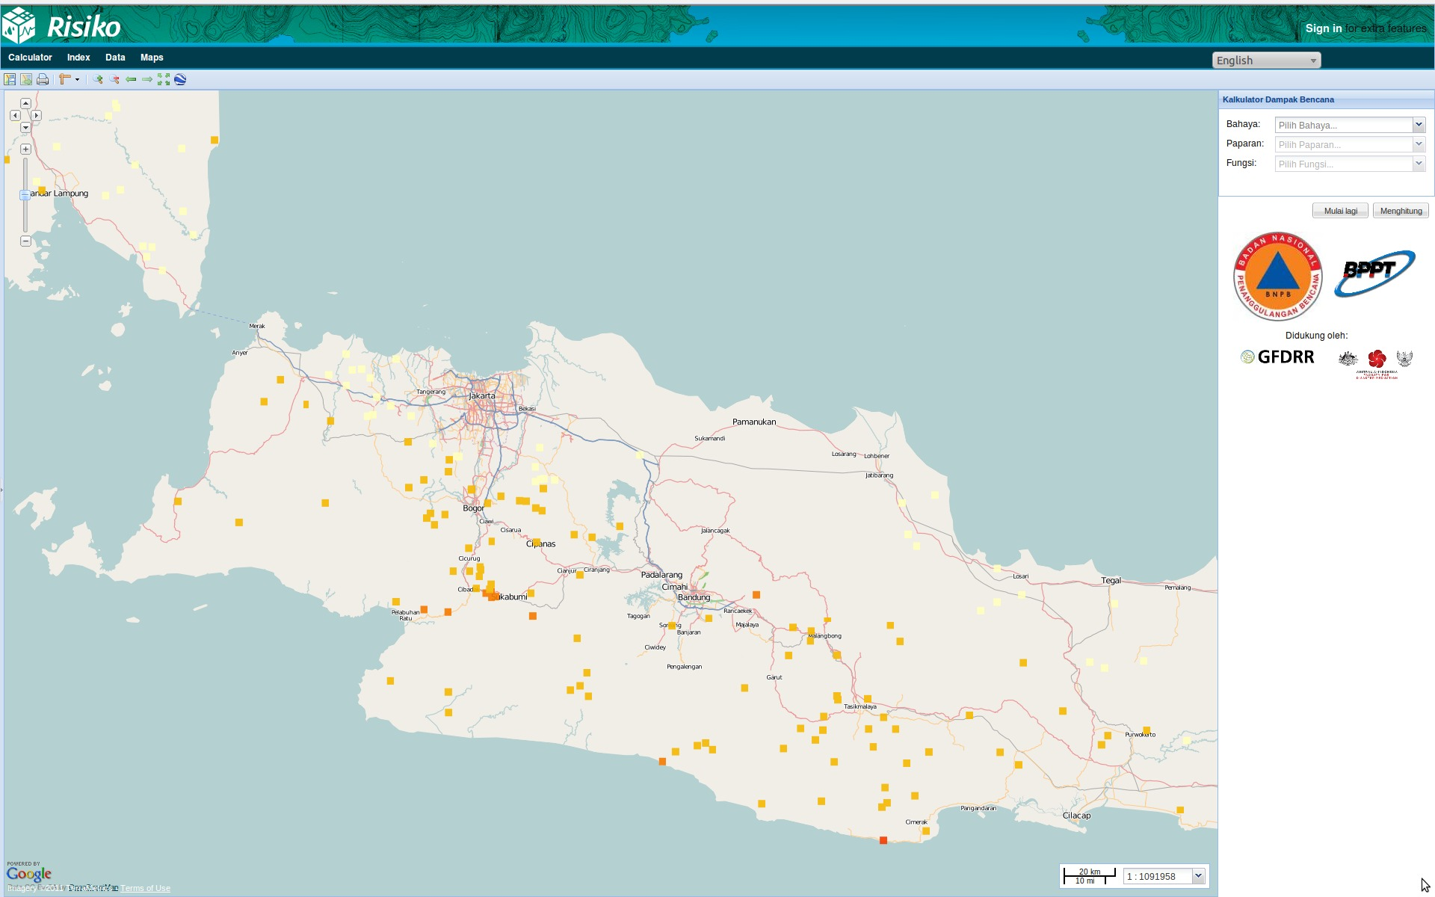

Slide 20
Impact Functions
Separating calculations from GIS and formats
Specific to hazard and exposure data
metadata keywords in layers (e.g. category:hazard, subcategory:earthquake)
plugin requirements stated in docstring
:param requires category=='hazard' and subcategory=='earthquake’
:param requires category=='exposure' and subcategory=='population’
The topic of Dr Ted Dunstone’s talk!

Slide 21
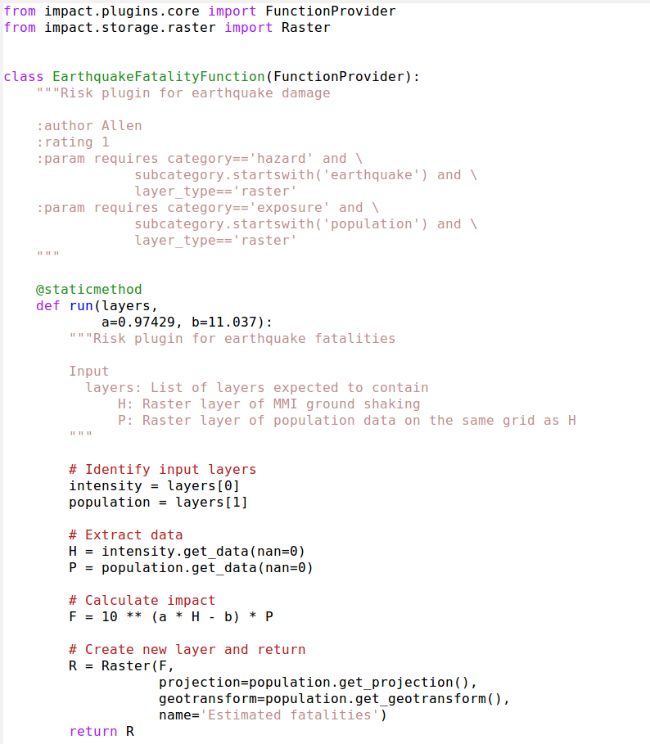

Slide 22
Why Python?
Productivity (let’s me focus on the problem)
Vast number of libraries
Memory management!
Unit testing framework
Extensibility (C or F77 only where needed)
I converted in 1999 and still happy

Slide 23
Challenges
Dependencies (Geoserver, GeoNode, GDAL)
Example: Asking for resolution 0.03x0.03
http://localhost:8001/geoserver/ows?version=1.0.0&service=wcs&request=getcoverage&format=GeoTIFF&store=false&coverage=shakemap&crs=EPSG:4326&bbox=122.5775,-2.0025,126.6025,2.0225&resx=0.03&resy=0.03
Pixel Size = (0.030037313432836,-0.030037313432836)
Work-in-progress but suffered from being demoed too often.

Slide 24
Future
Early days!
Risiko to help set standards for risk modelling
Abstracting the GIS components
Use of data standards (OGC)
Facilitate collection of exposure data
Other types of modelling (environmental, socio-economic)
Grow development community

Slide 25
Thank You
Source (github), issue tracker and docs:
http://riskinabox.org
Ole.Nielsen@aifdr.org

Slide 27
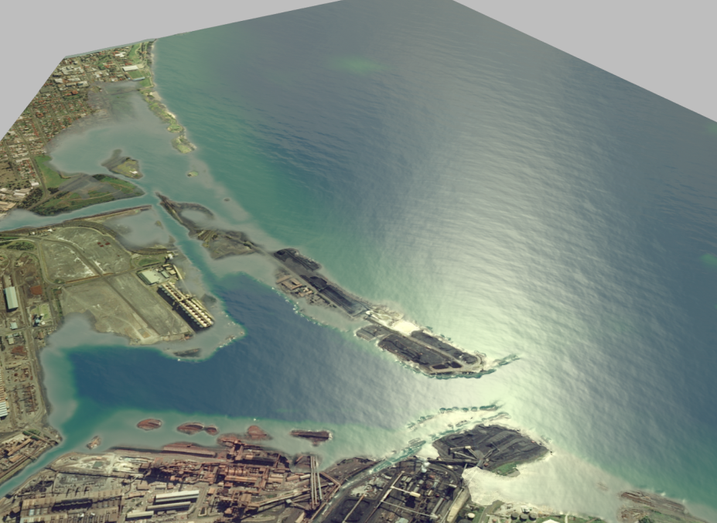
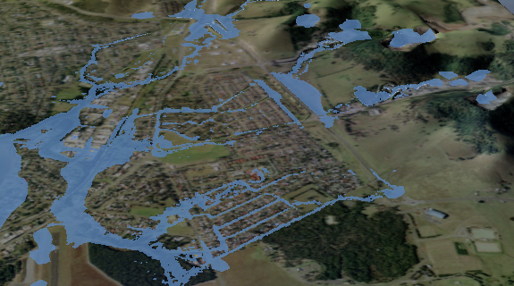
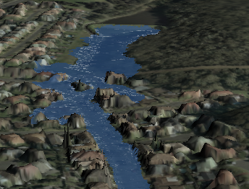
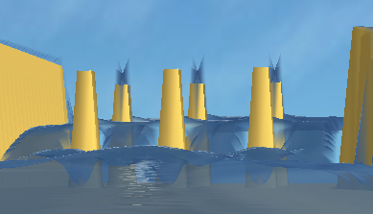
What is ANUGA
Tsunami Inundation
Riverine Flooding
Hydraulic Engineering
Dam Breaks

Slide 28
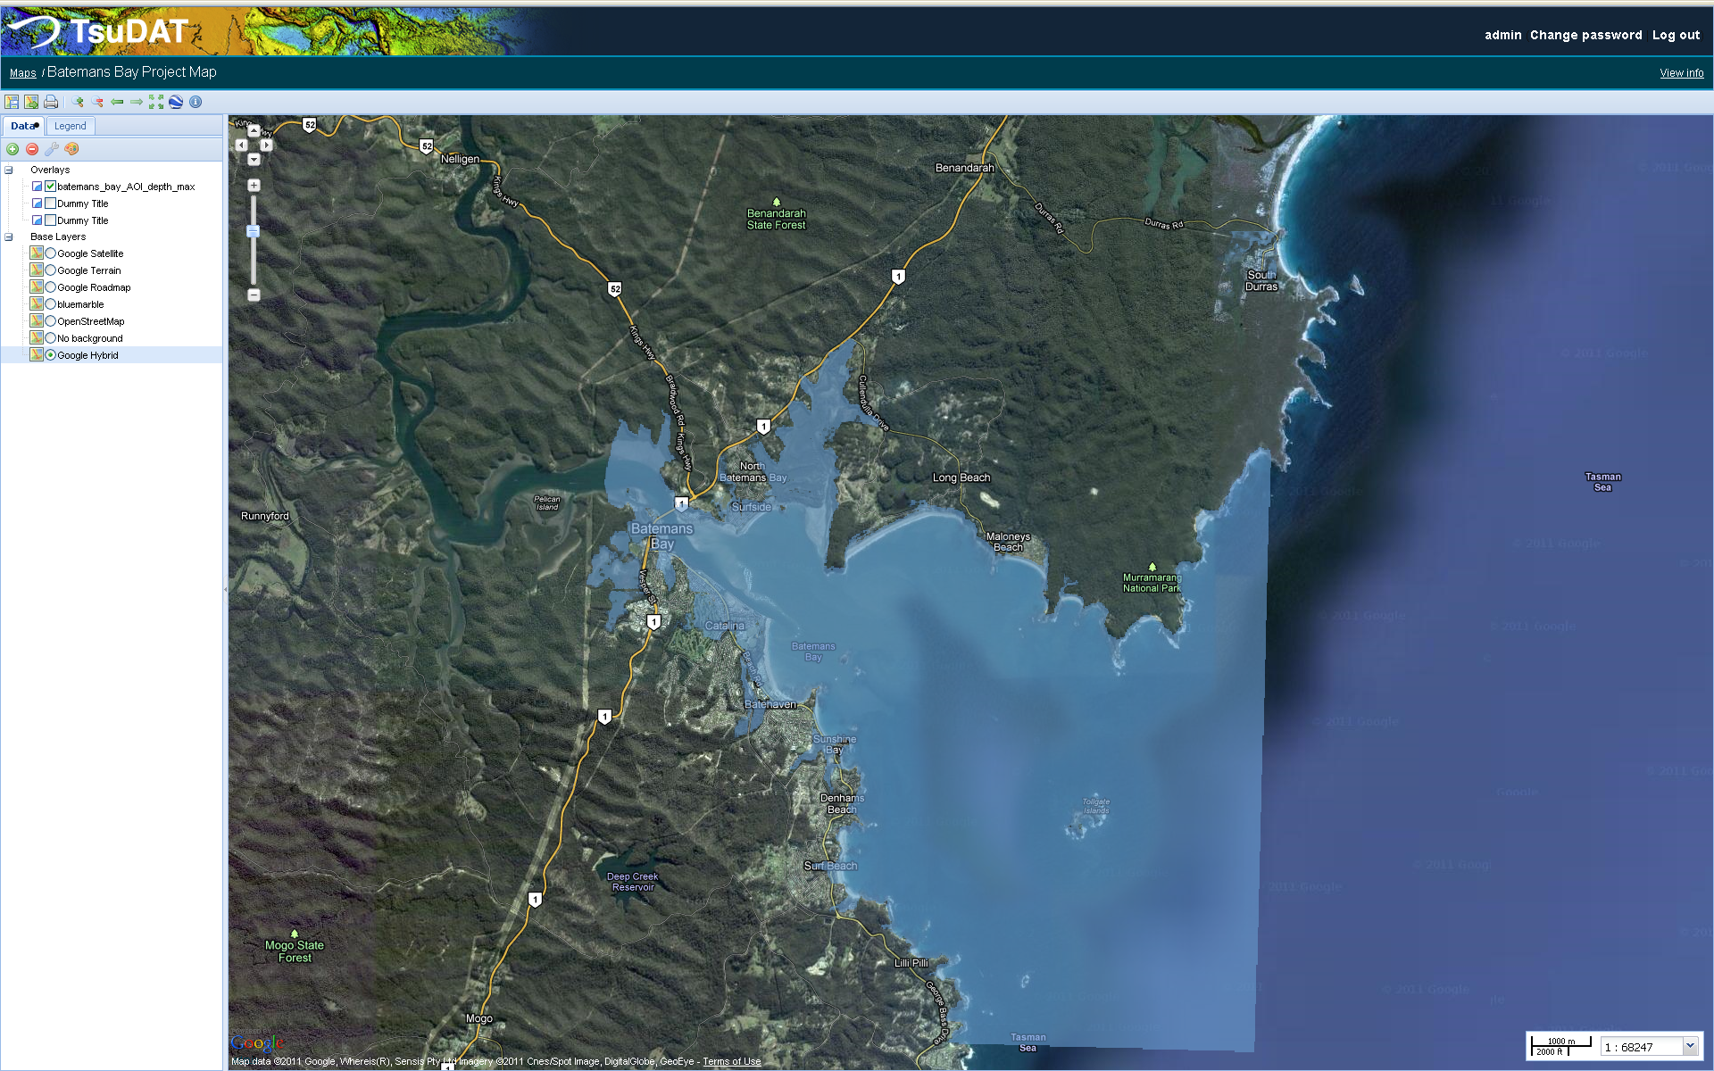

Slide 29
What is ANUGA
Tsunami Inundation
Riverine Flooding
Hydraulic Engineering
Dam Breaks

Slide 31
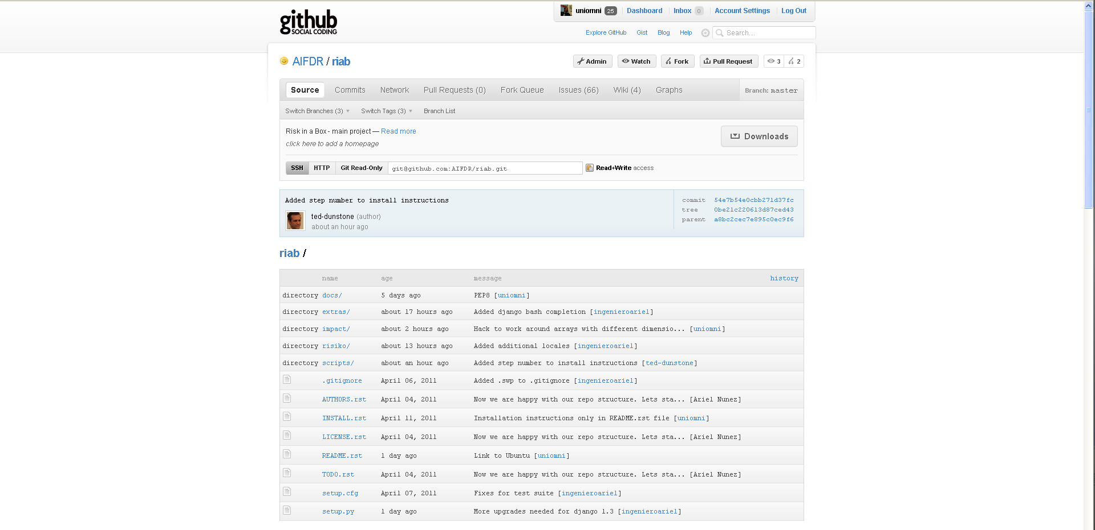
Source (github), issue tracker and docs

